Slide 1

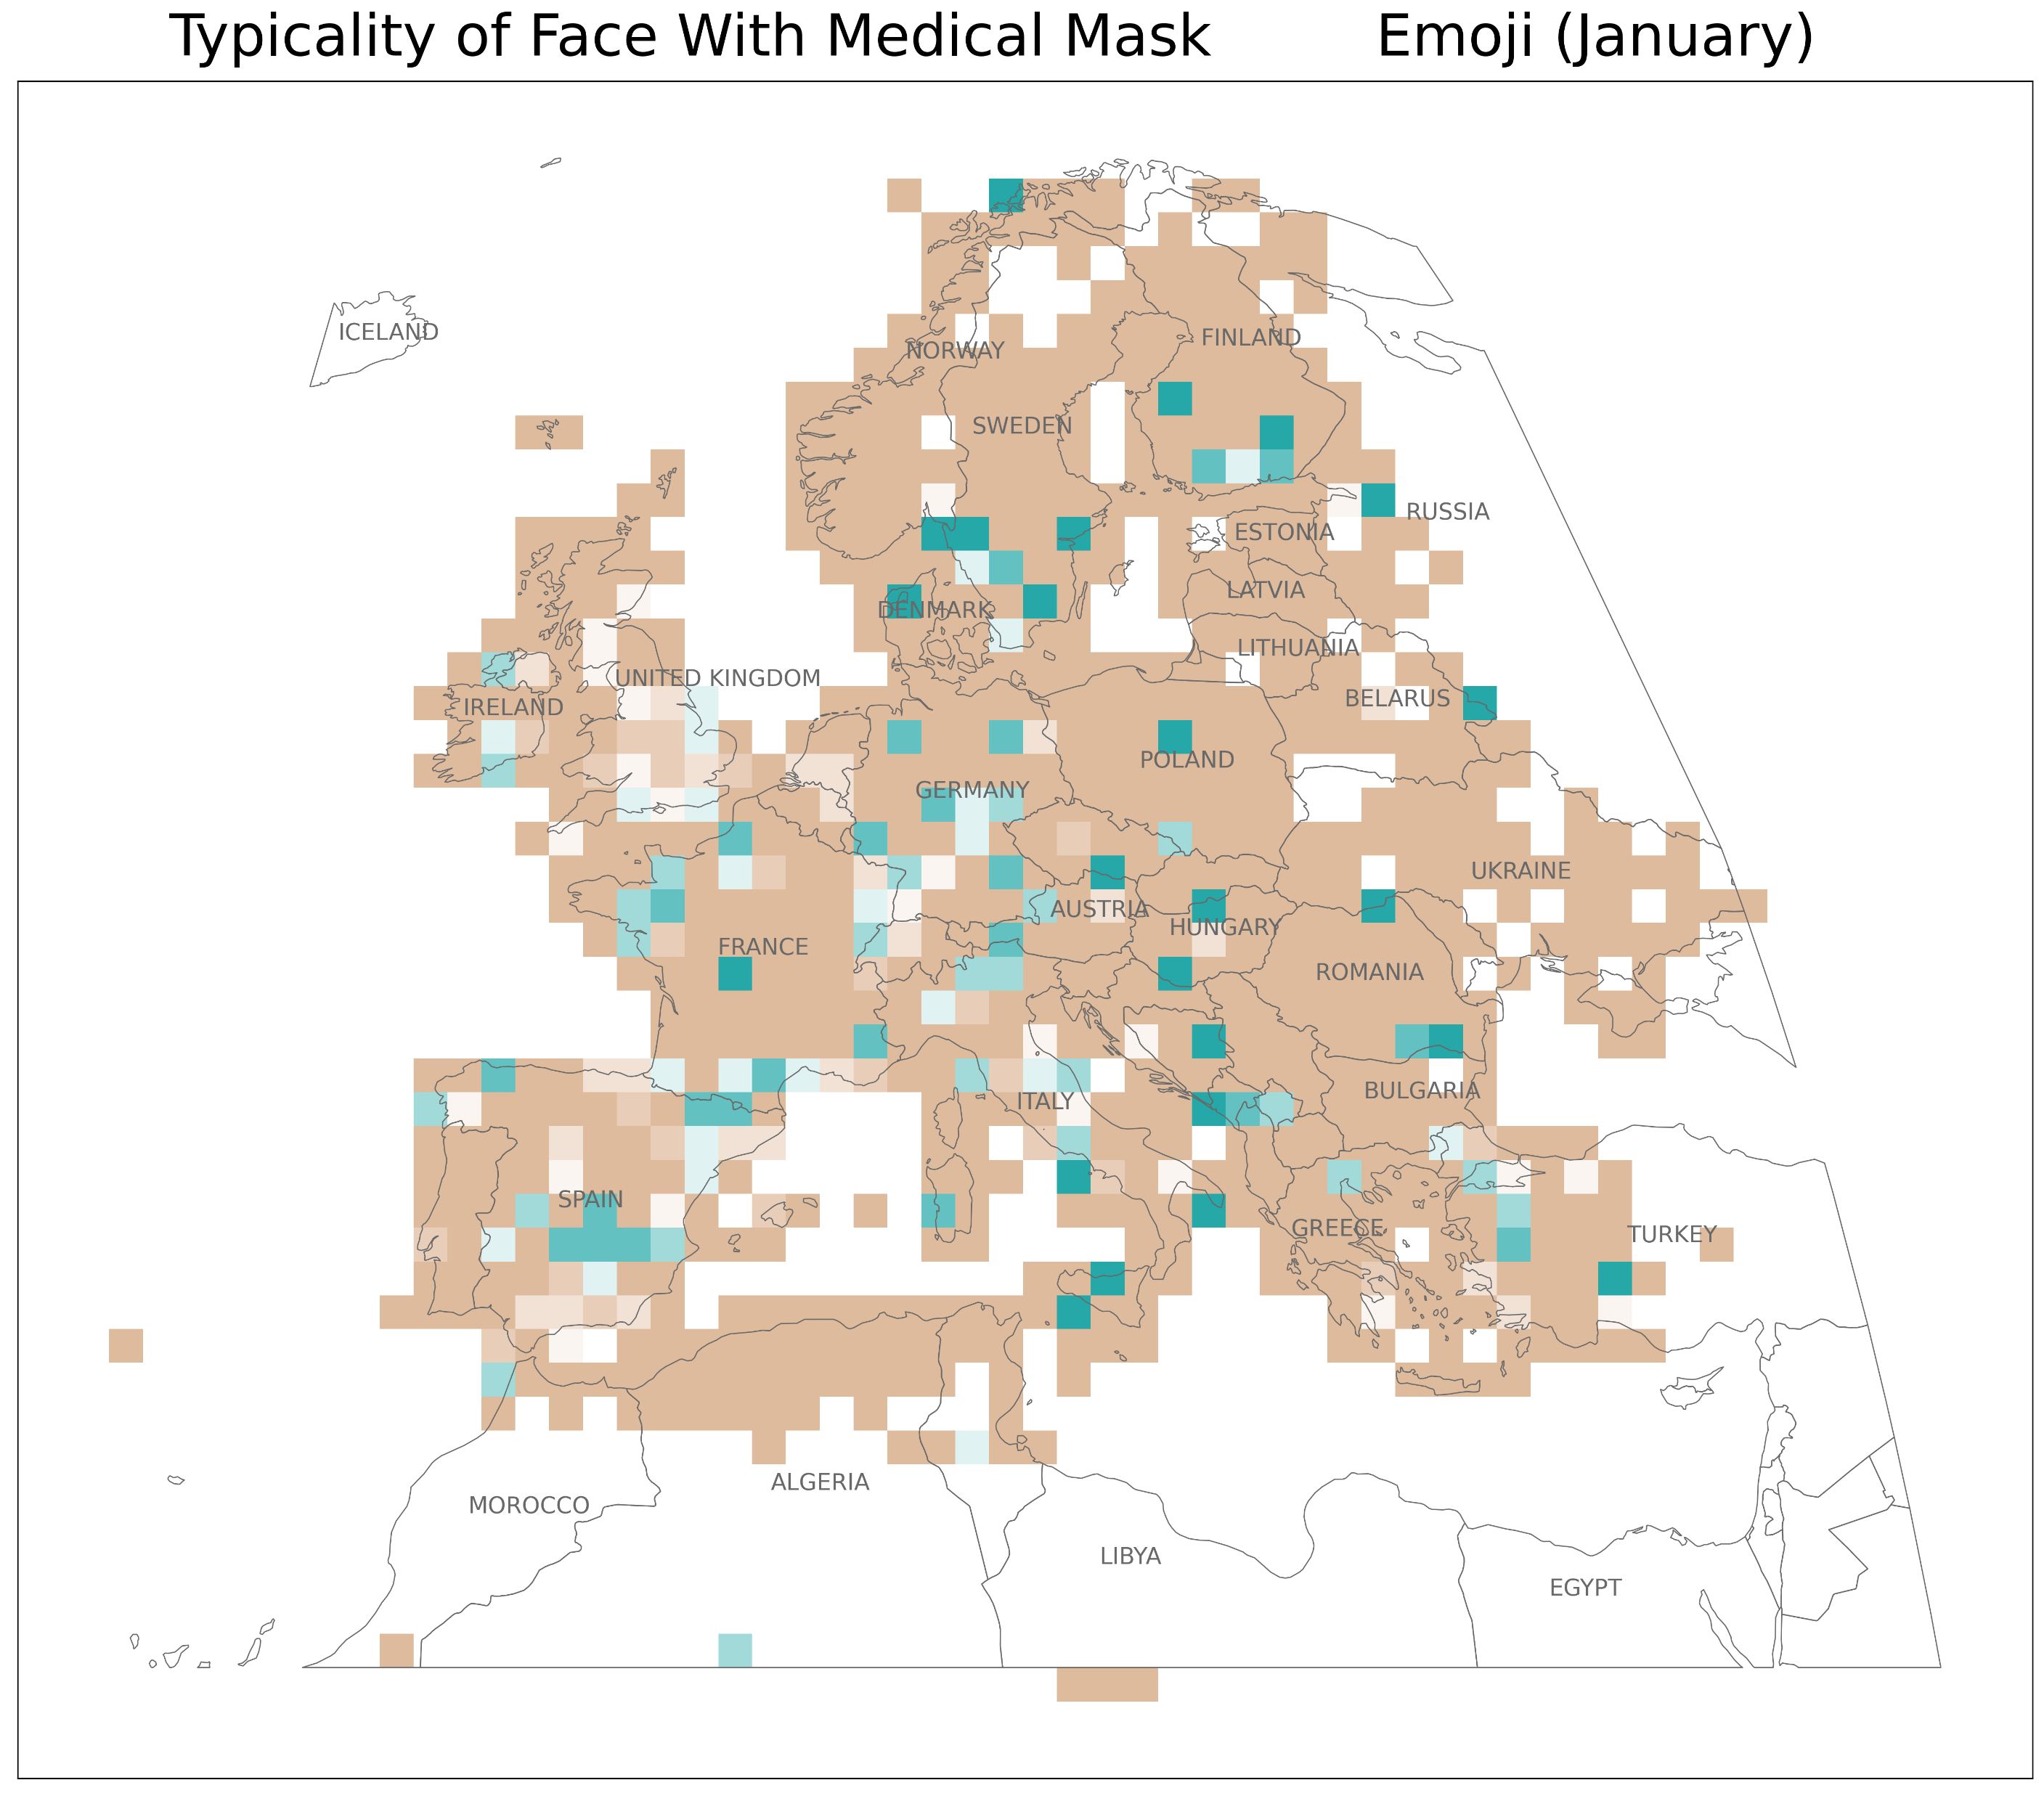
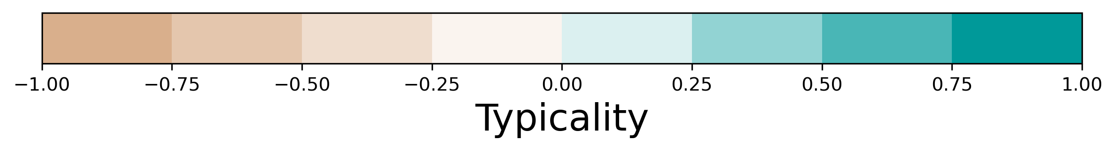
Data Sources: Natural Earth, Twitter database of the Technical University of Dresden Institute of Cartography
Author: Samantha Levi

Slide 2
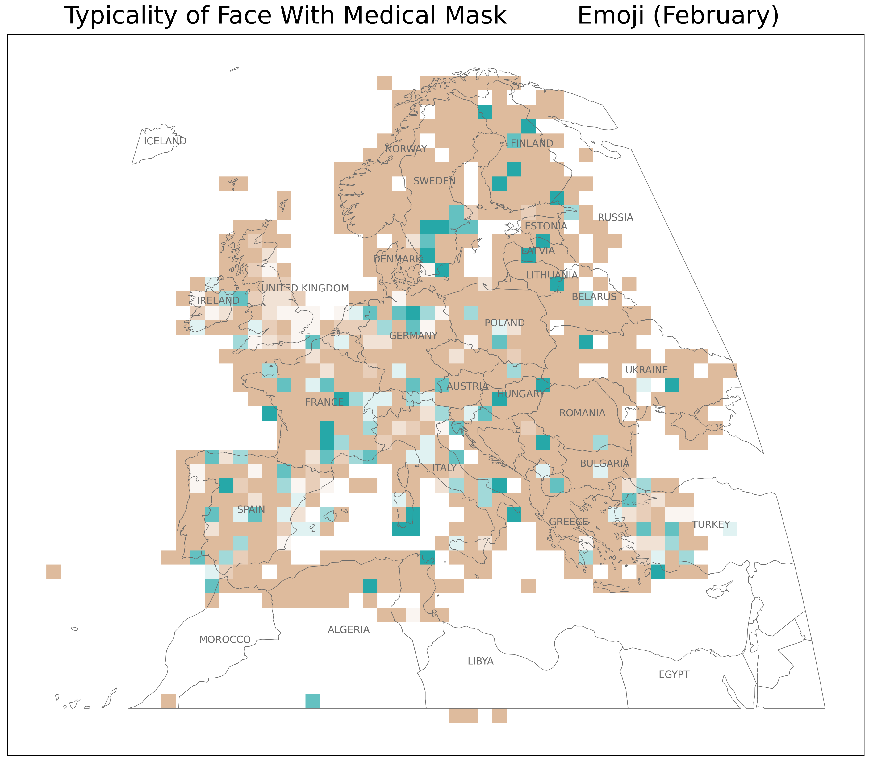
Data Sources: Natural Earth, Twitter database of the Technical University of Dresden Institute of Cartography
Author: Samantha Levi

Slide 3
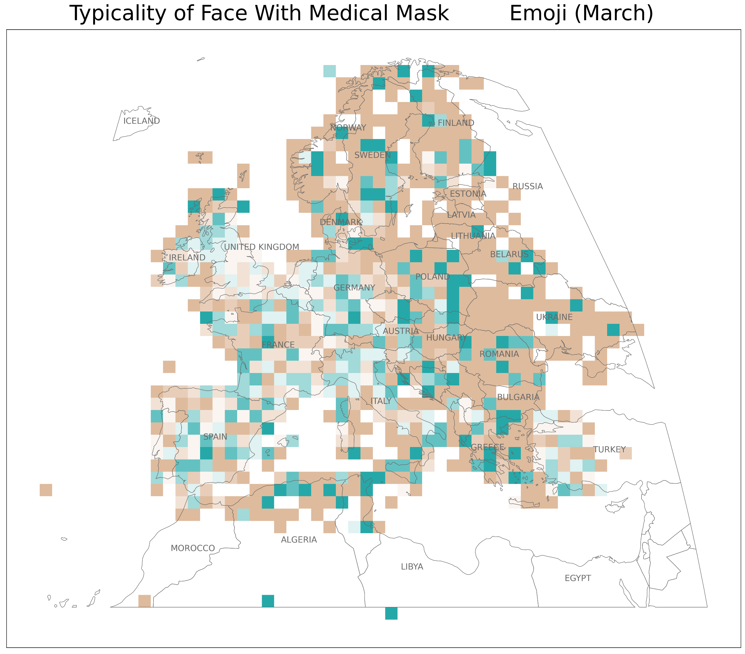
Data Sources: Natural Earth, Twitter database of the Technical University of Dresden Institute of Cartography
Author: Samantha Levi

Slide 4
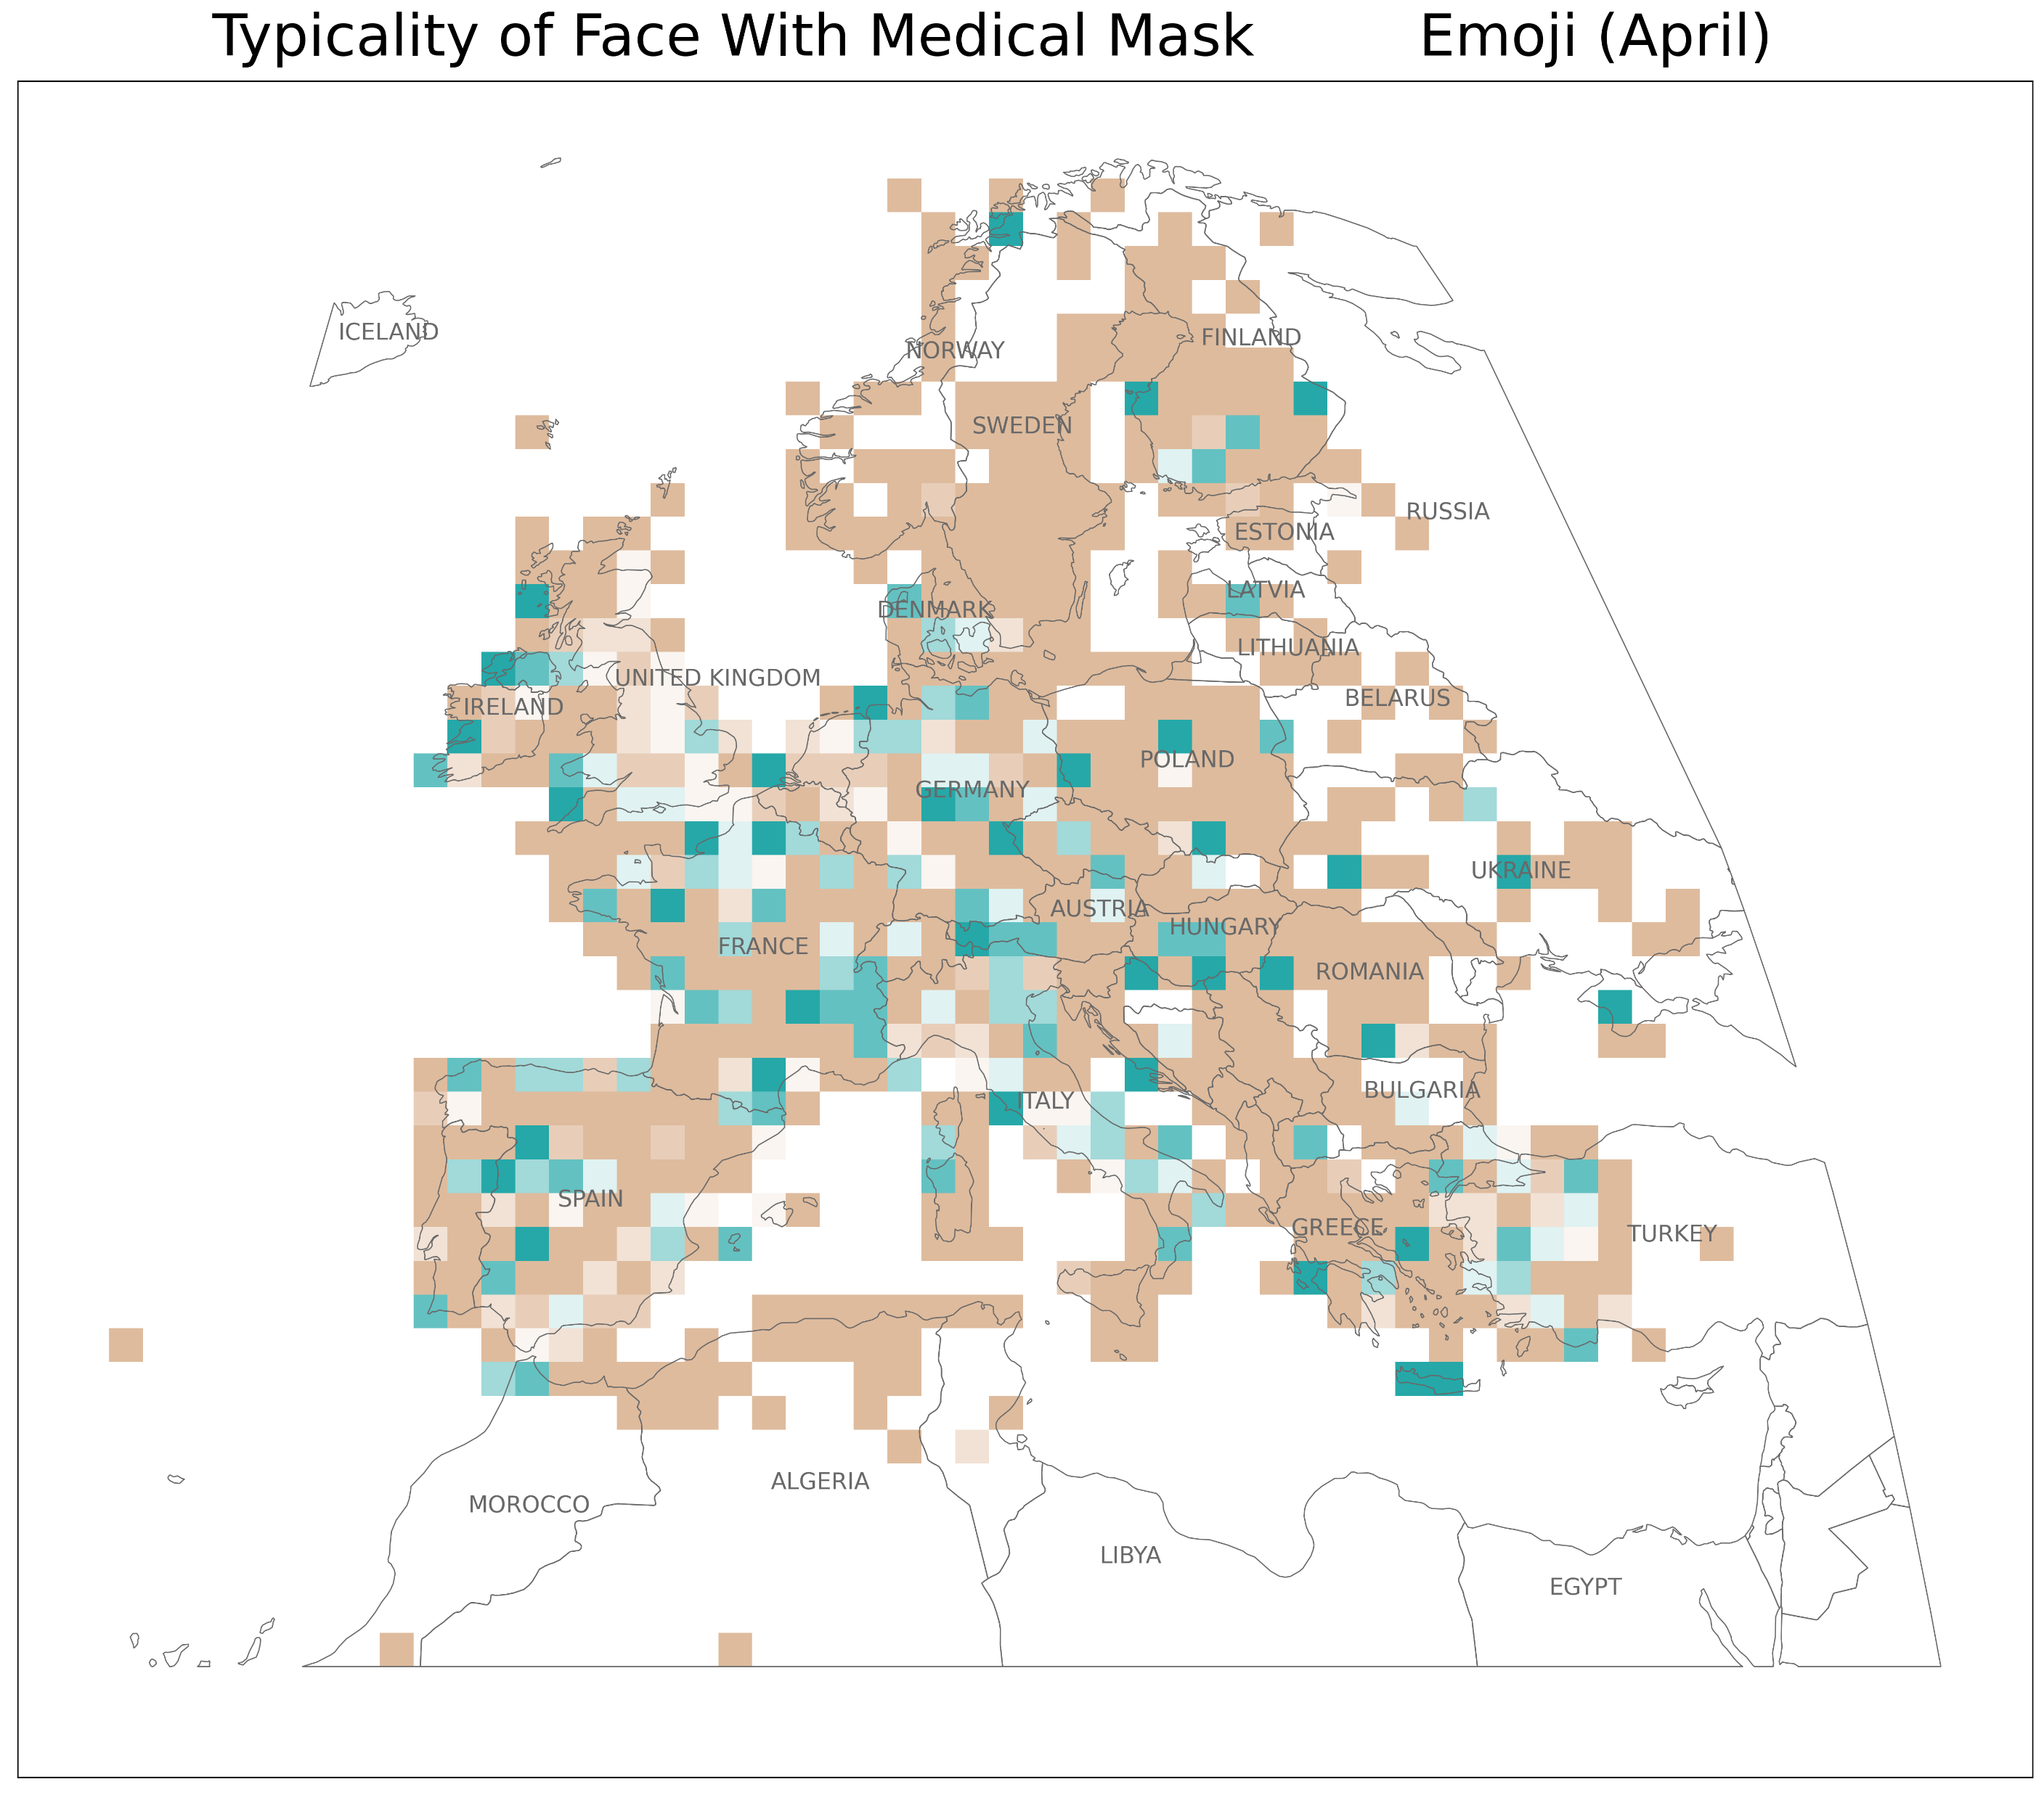
Data Sources: Natural Earth, Twitter database of the Technical University of Dresden Institute of Cartography
Author: Samantha Levi

Slide 5
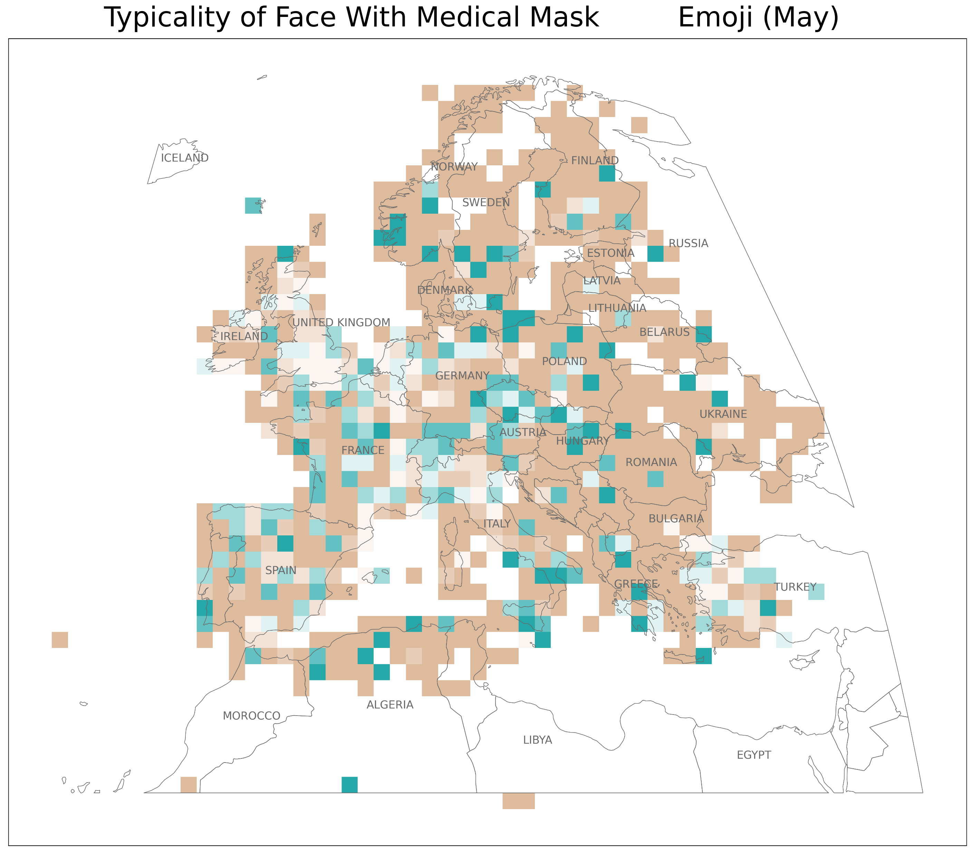
Data Sources: Natural Earth, Twitter database of the Technical University of Dresden Institute of Cartography
Author: Samantha Levi

Slide 6
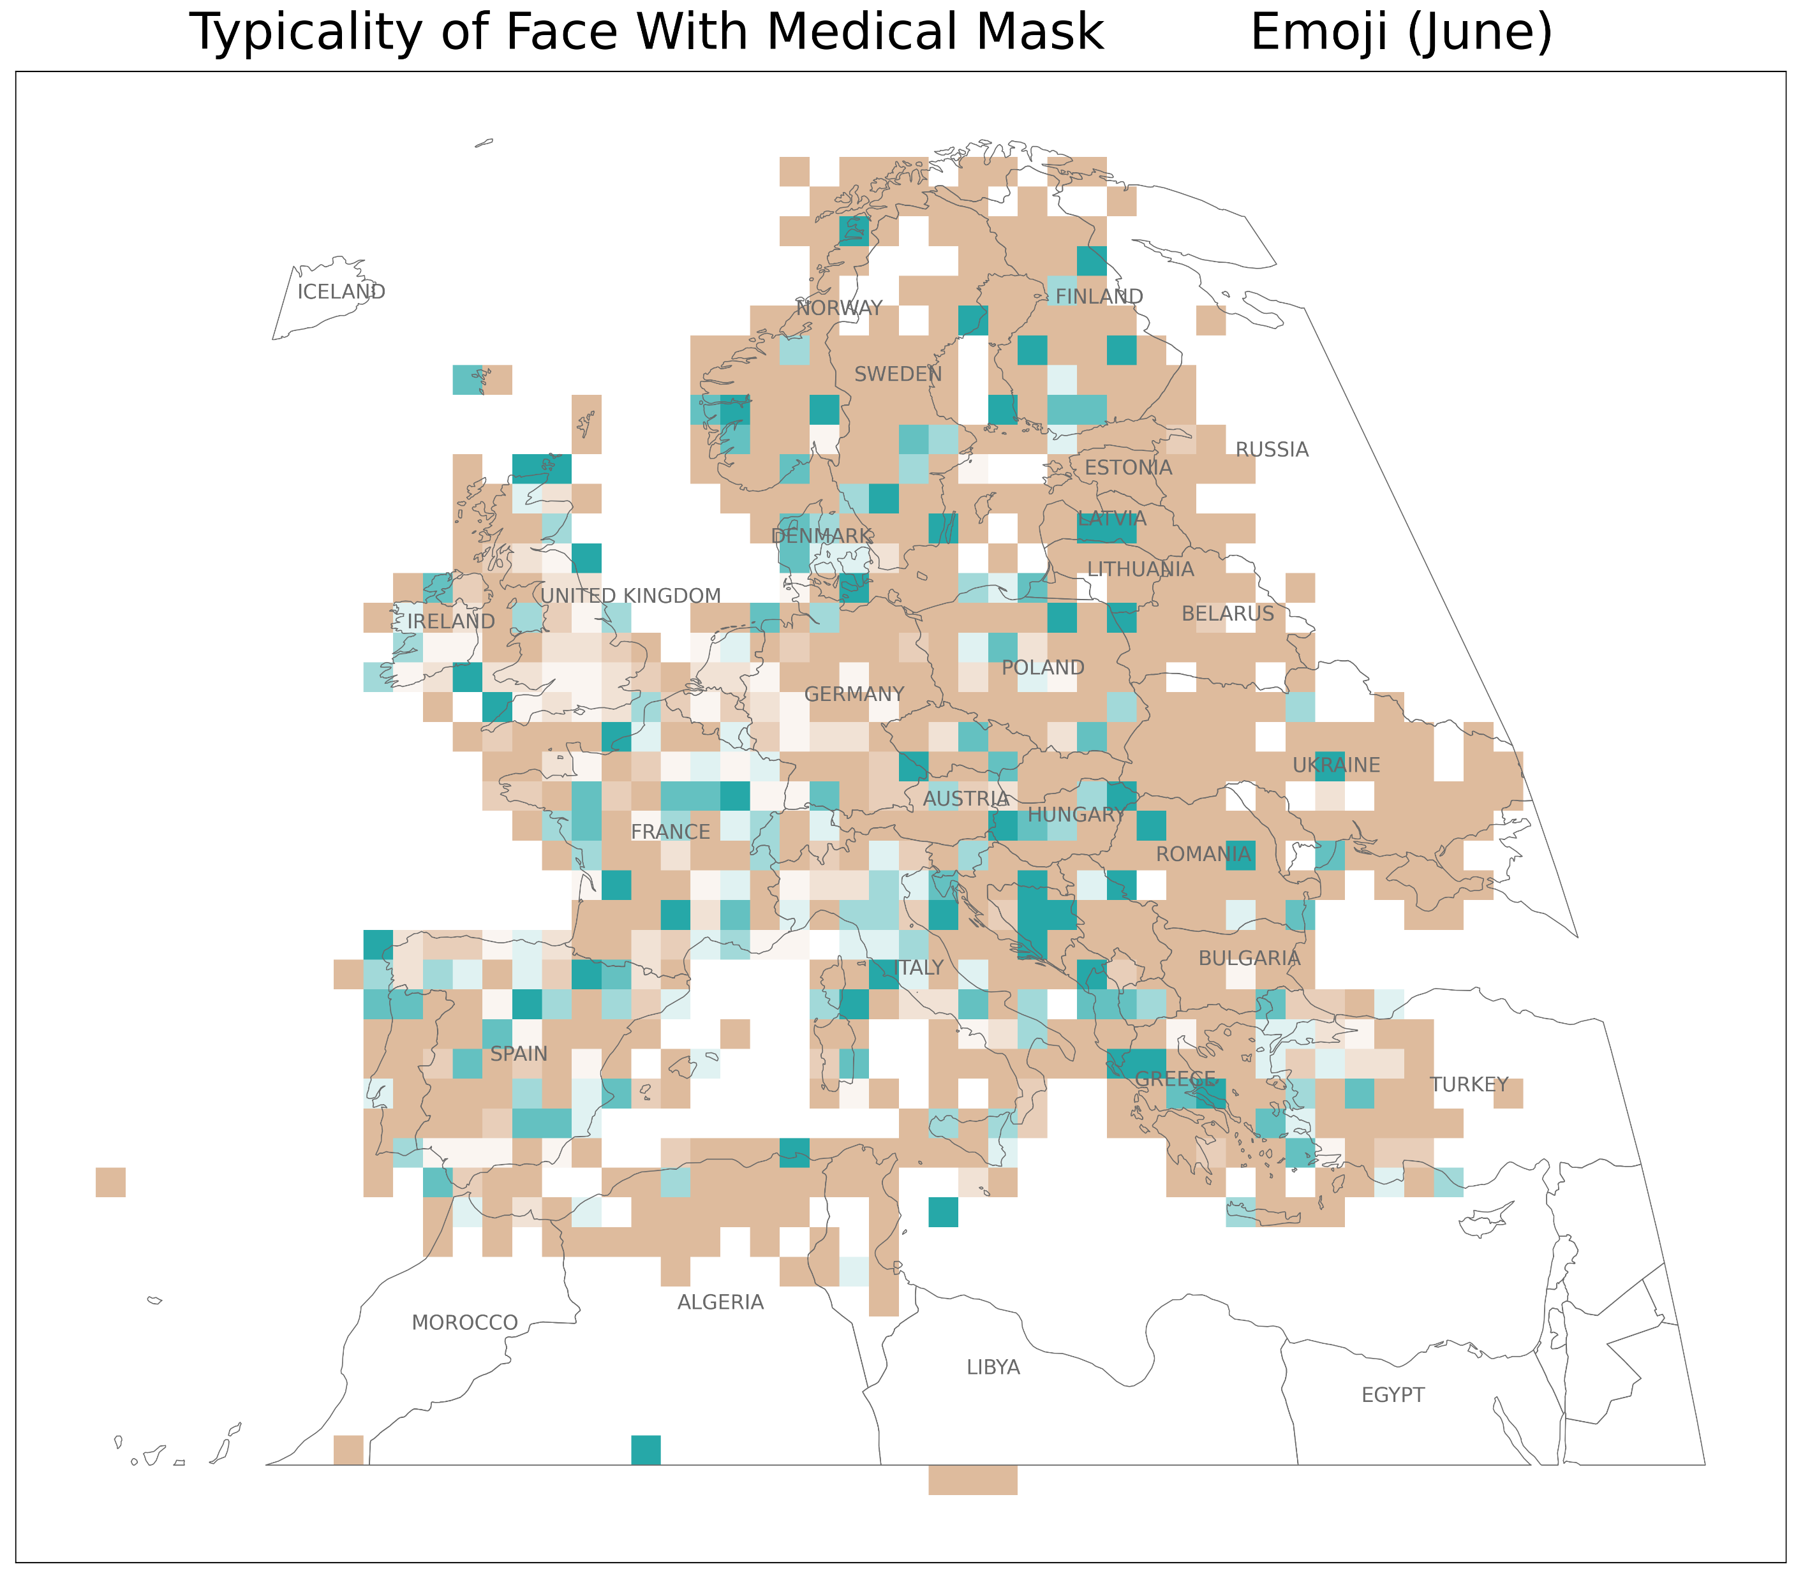
Data Sources: Natural Earth, Twitter database of the Technical University of Dresden Institute of Cartography
Author: Samantha Levi

Slide 7
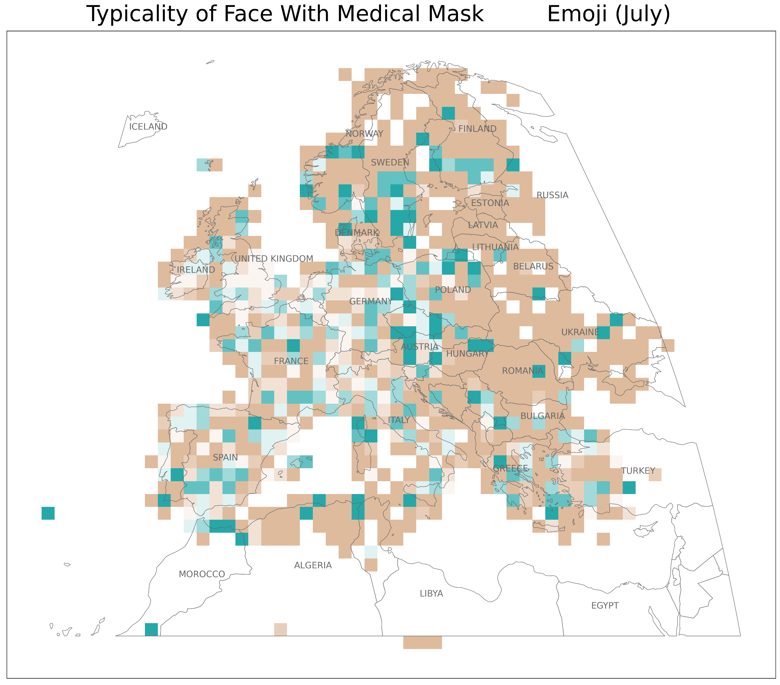
Data Sources: Natural Earth, Twitter database of the Technical University of Dresden Institute of Cartography
Author: Samantha Levi

Slide 8
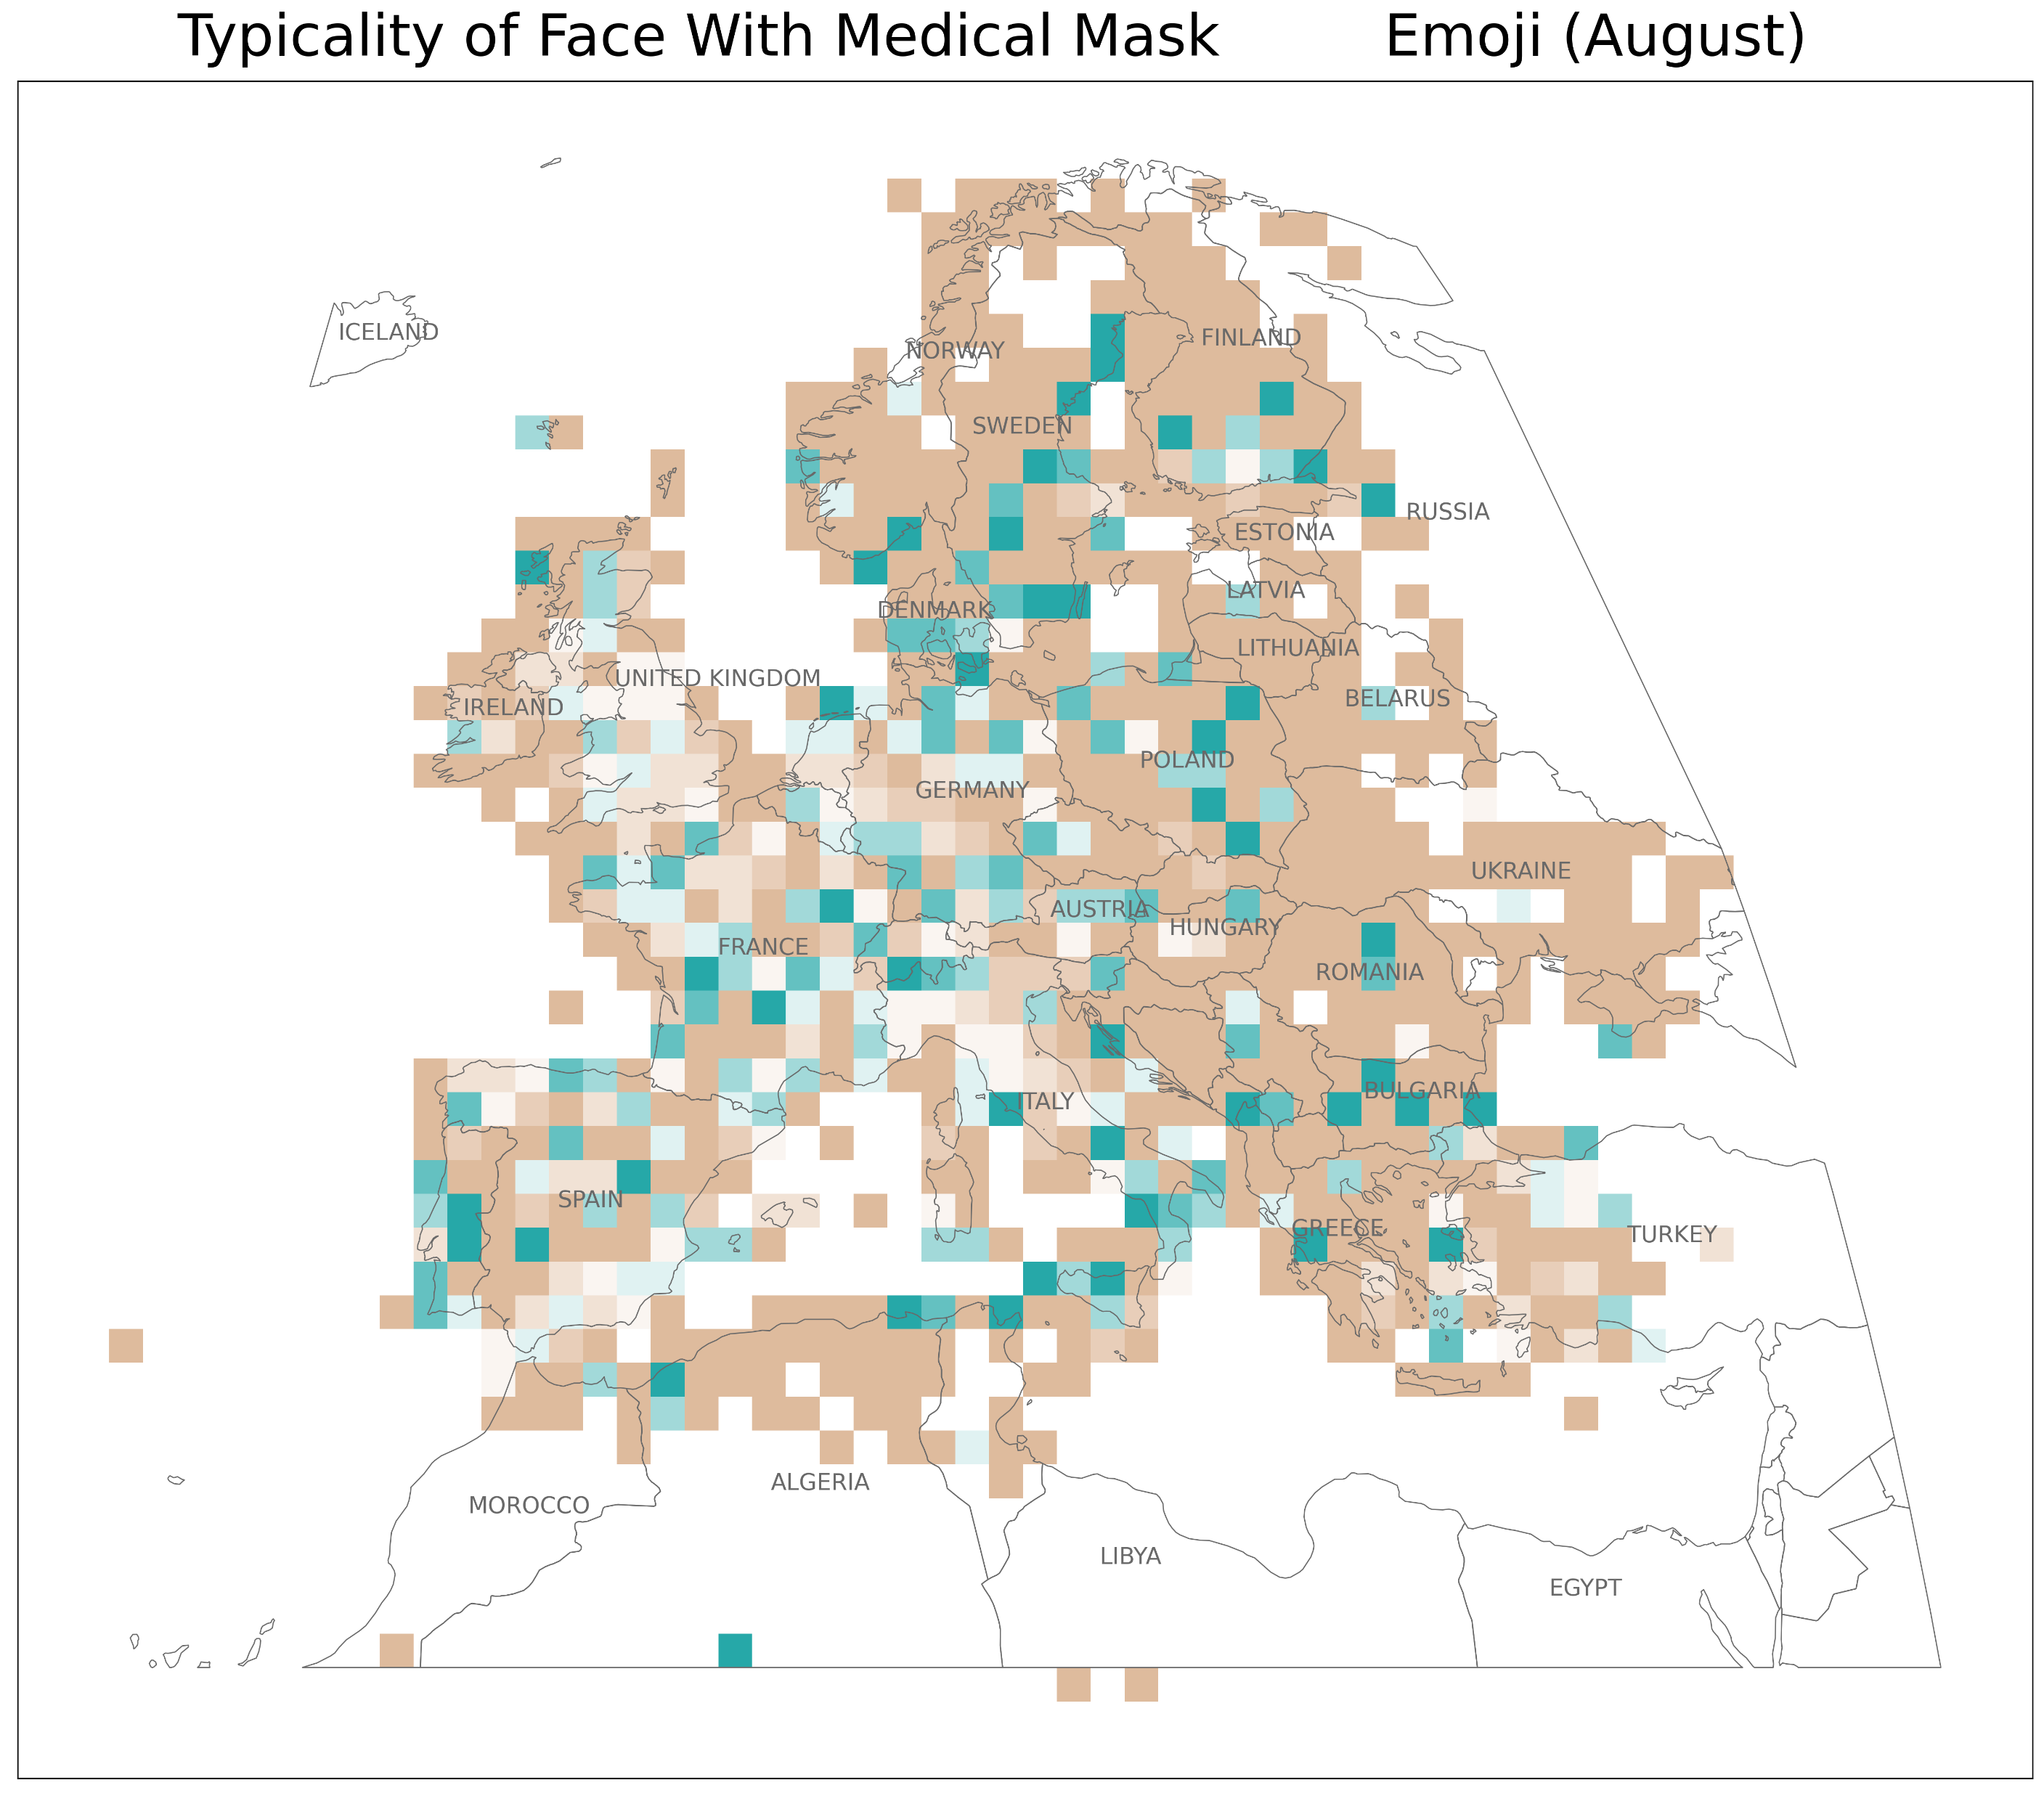
Data Sources: Natural Earth, Twitter database of the Technical University of Dresden Institute of Cartography
Author: Samantha Levi

Slide 9
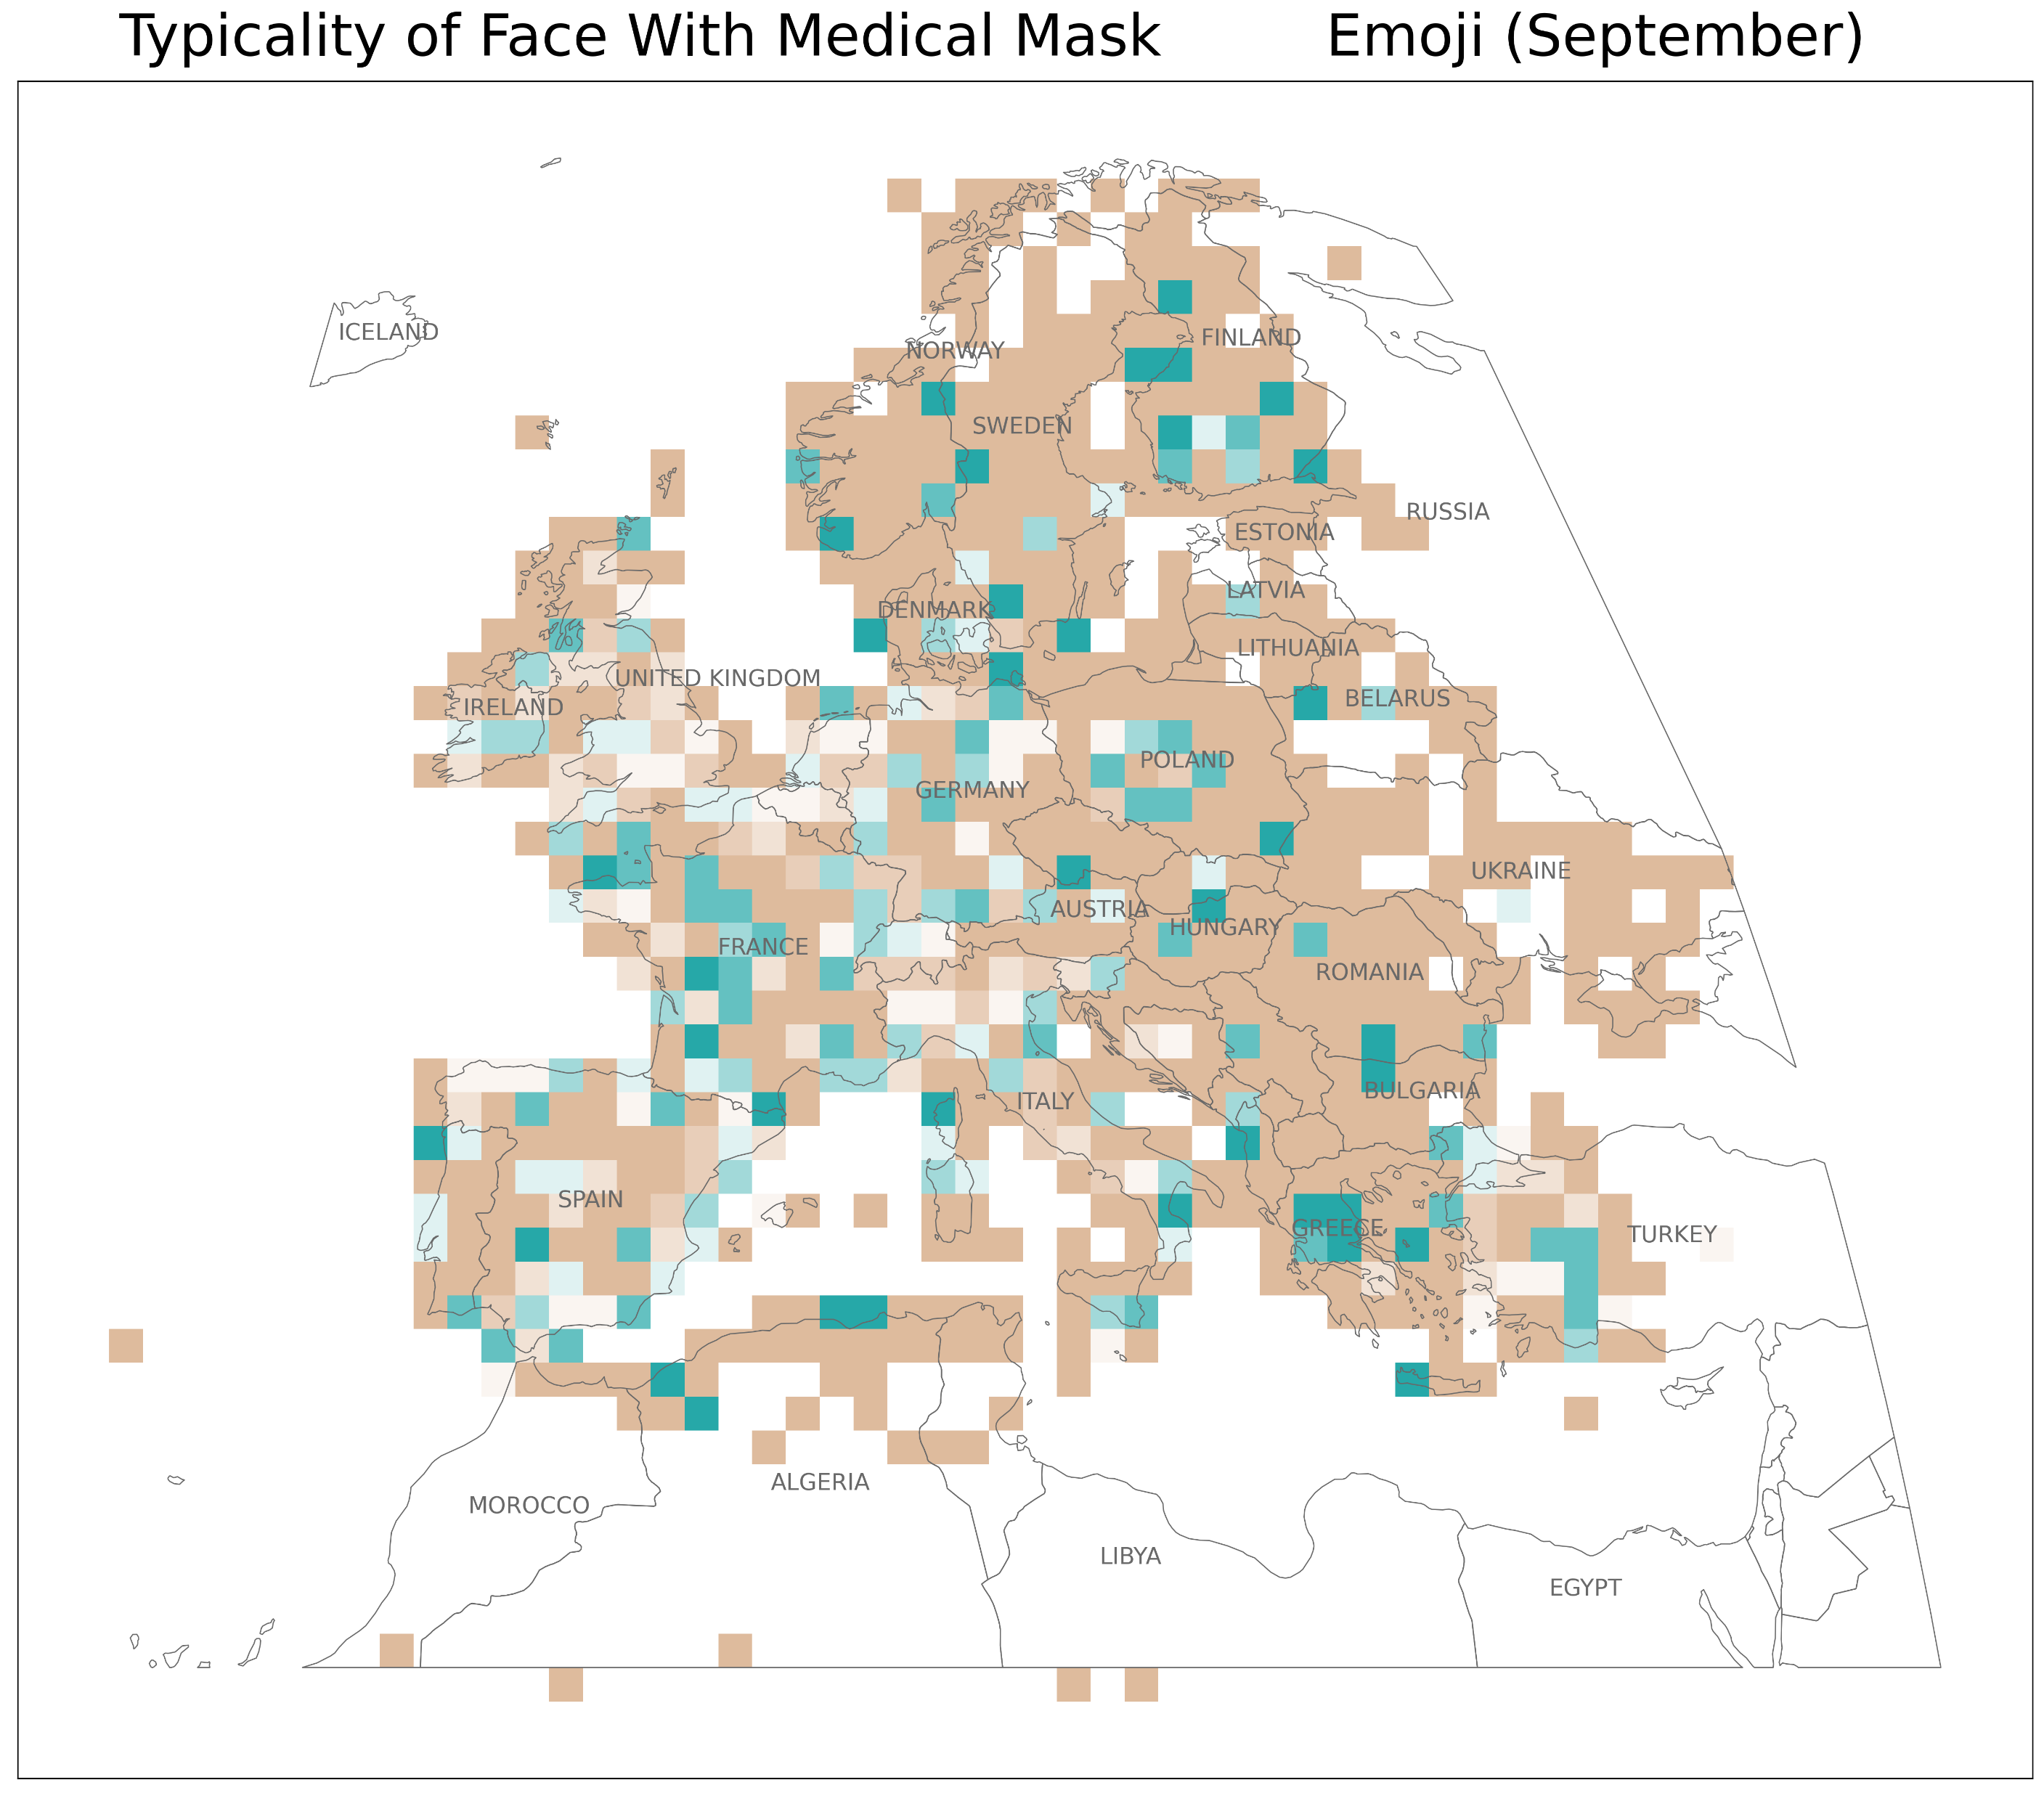
Data Sources: Natural Earth, Twitter database of the Technical University of Dresden Institute of Cartography
Author: Samantha Levi

Slide 10
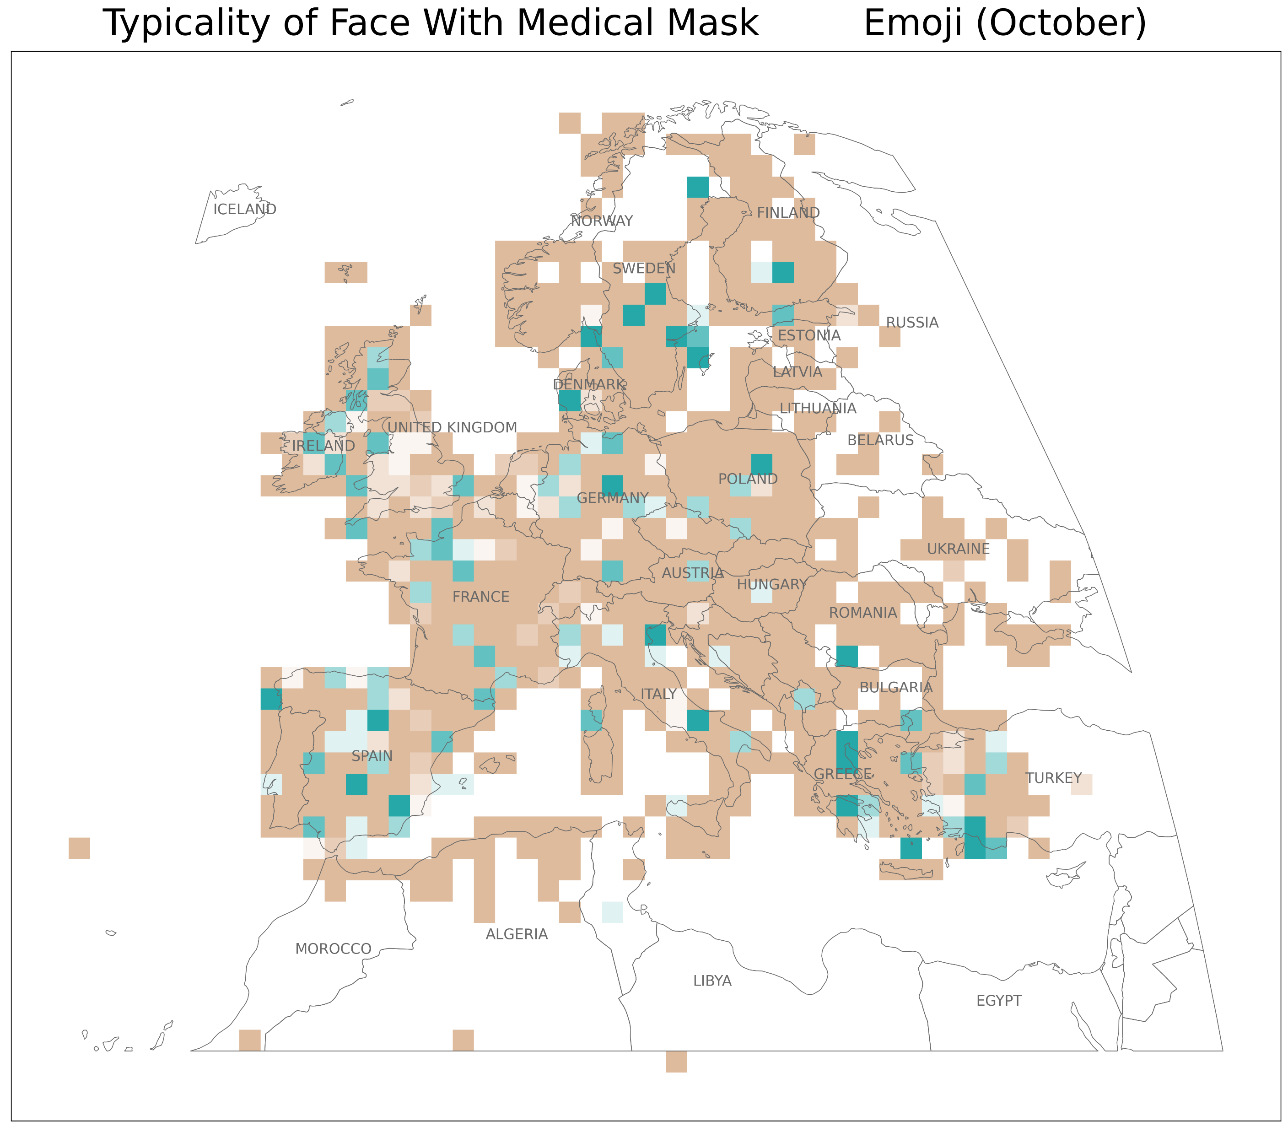
Data Sources: Natural Earth, Twitter database of the Technical University of Dresden Institute of Cartography
Author: Samantha Levi

Slide 11
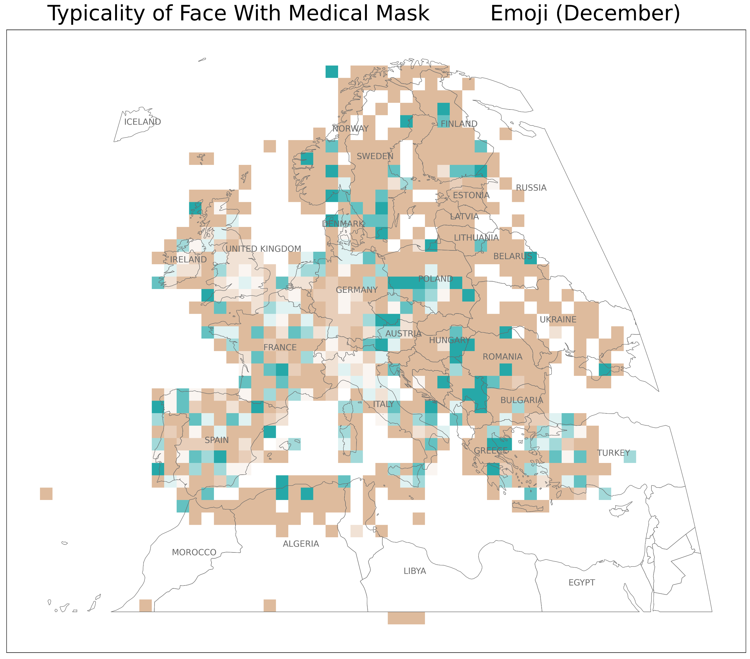
Data Sources: Natural Earth, Twitter database of the Technical University of Dresden Institute of Cartography
Author: Samantha Levi

